Slide 1
Travlendar+
Design Document

Slide 2
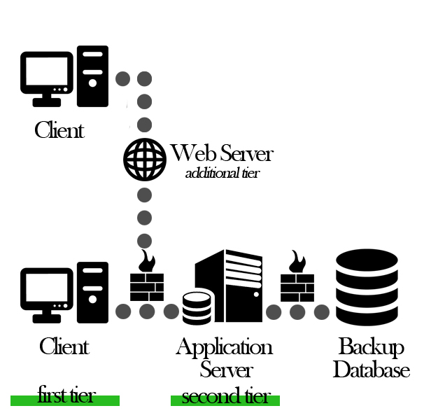
Physical Architecture

Slide 3
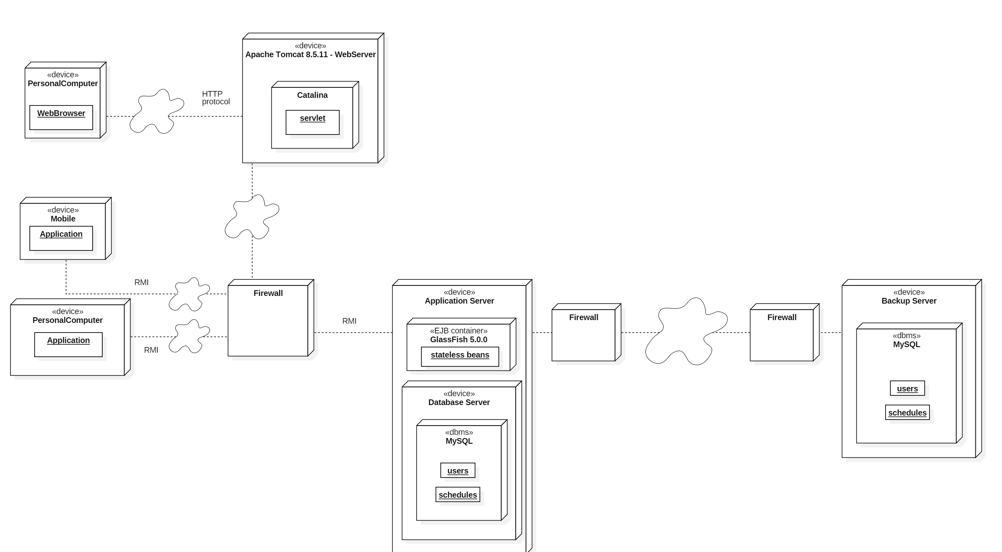
Deployment View

Slide 4
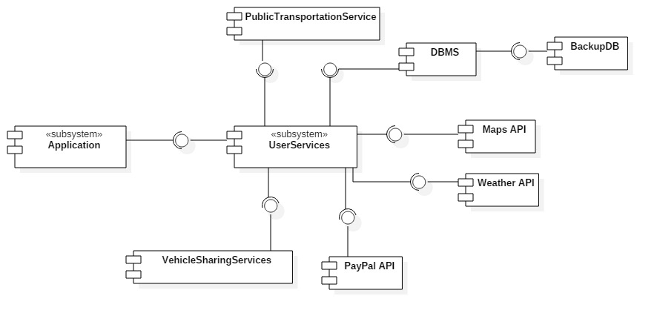
Component View

Slide 5
